Slide 1
Midterm Presentation
Luke McConnell, Julie Hum, Katharine Moncrieffe

Slide 2
Problem Statement
Our problem is to design a differential drive robot capable of performing precise movements, obstacle detection, and line-following. Our robot should be able to move accurately forward and backward, turn precisely, and stop at specified distances from walls. It will also detect and follow lines, signaling completion with an indicator. For more advanced challenges, it can carry out velocity-controlled movement and even interact with objects like cubes and ping pong balls to complete tasks.

Slide 3
Research
We thought about the purpose of each component and its optimal placement on our robot.
For example:
IR Reflective Sensors for line following would best be placed in the front of the robot, allowing the sensors to detect the line position relative to the robot’s center and direction
Optical Interrupt Sensors for wheel encoders would best be placed near the motors to track the rotations of the wheel and collect data about speed and distance traveled.

Slide 4
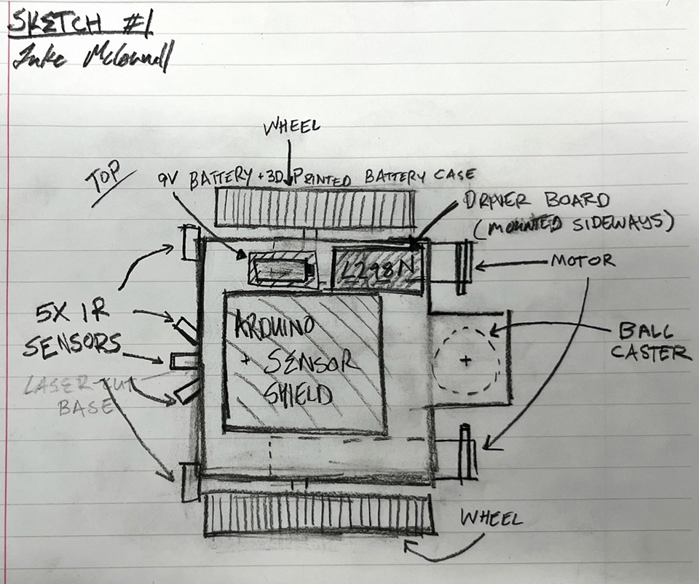
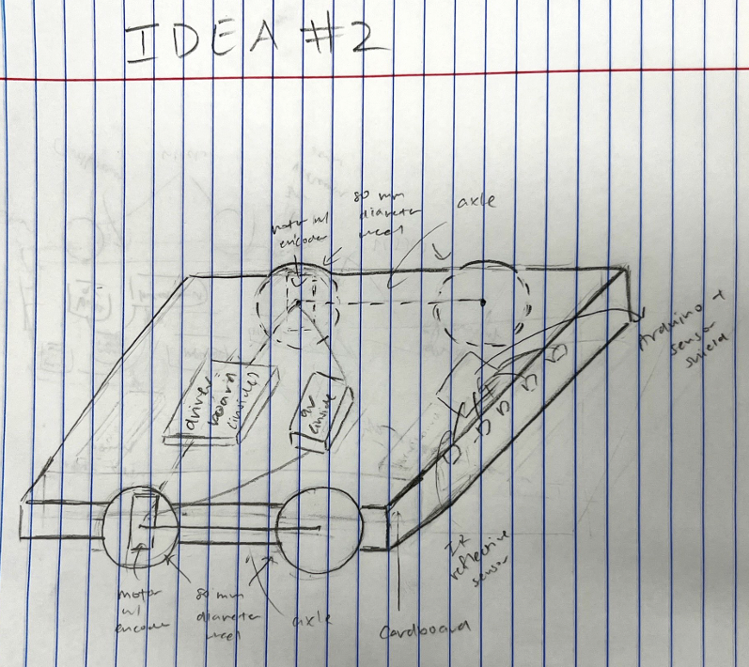

Slide 5
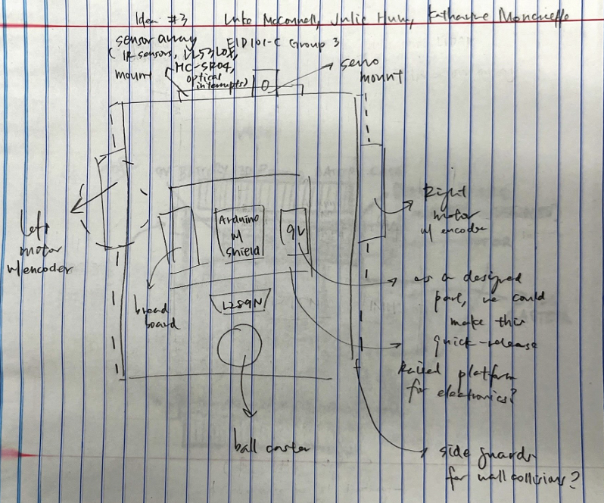
Our Winning Sketch!

Slide 6
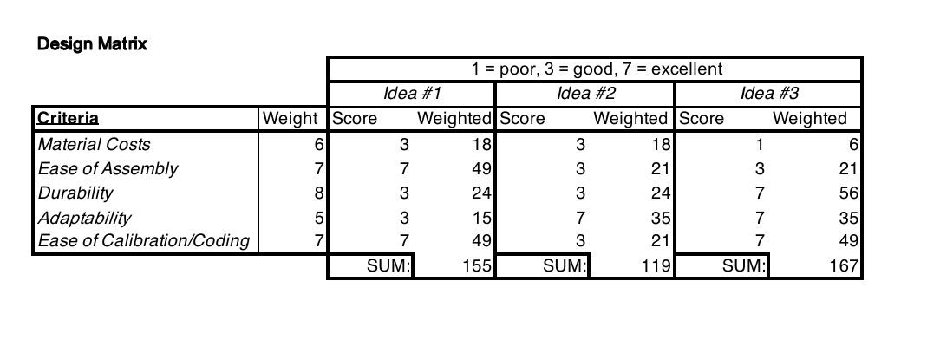

Slide 7
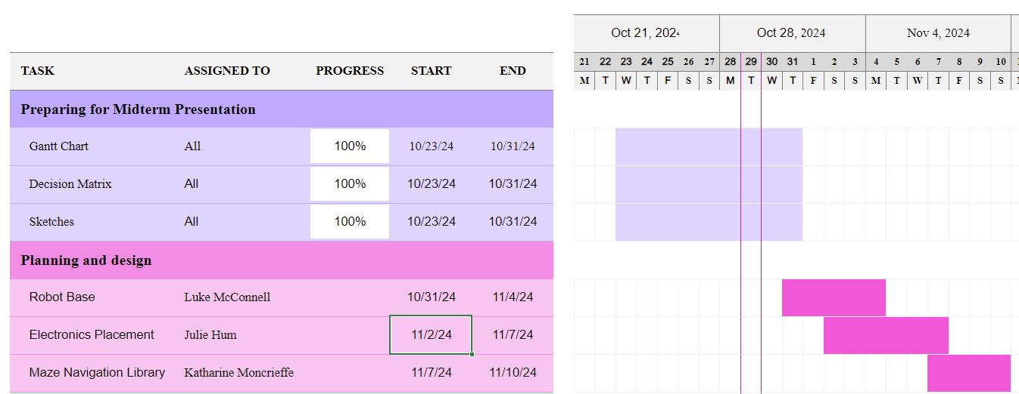

Slide 8
Component | Description | Quantity | Approx. Unit Price (USD) | Total Price (USD)
IR Reflective Sensors | Infrared sensors for detecting lines and surface contrast, used in line-following applications. | 5 | $2 | $10
Optical Interrupt Sensors | Sensors for tracking wheel rotation, providing position feedback for precise movement control. | 2 | $3 | $6
VL53L0 Lidar Sensor | Laser-based sensor for short-range distance measurement, useful for obstacle detection. | 1 | $15 | $15
HC-SR04 Ultrasonic Sensor | Ultrasonic distance sensor for detecting obstacles at longer ranges than the Lidar. | 1 | $2 | $2
MPU6050 IMU | Inertial measurement unit combining accelerometer and gyroscope for orientation tracking. | 1 | $5 | $5

